Slide 1
GIFTED
Crowdsourcing Workshop
By Amit Chen, Evgeny Agronsky, Tomer Ben-Kereth , Yotam Ronen and Yehonatan Sayag

Slide 3
The MAIN IDEA behind gifted
Not once have we found ourselves struggling to find a perfect gift for our beloved ones.
Gifted is a crowdsourcing-based web application that will help you find it.
Based on a database of gifts bought by various users, Gifted will offer you the best match.

Slide 4
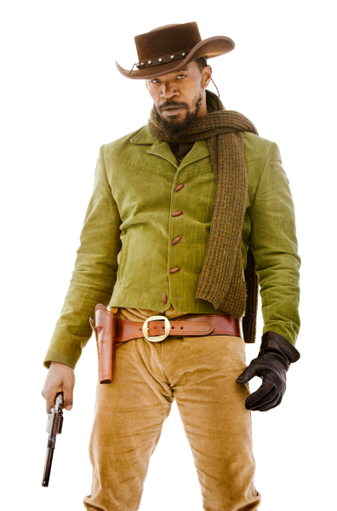
Development - Technologies

Slide 5
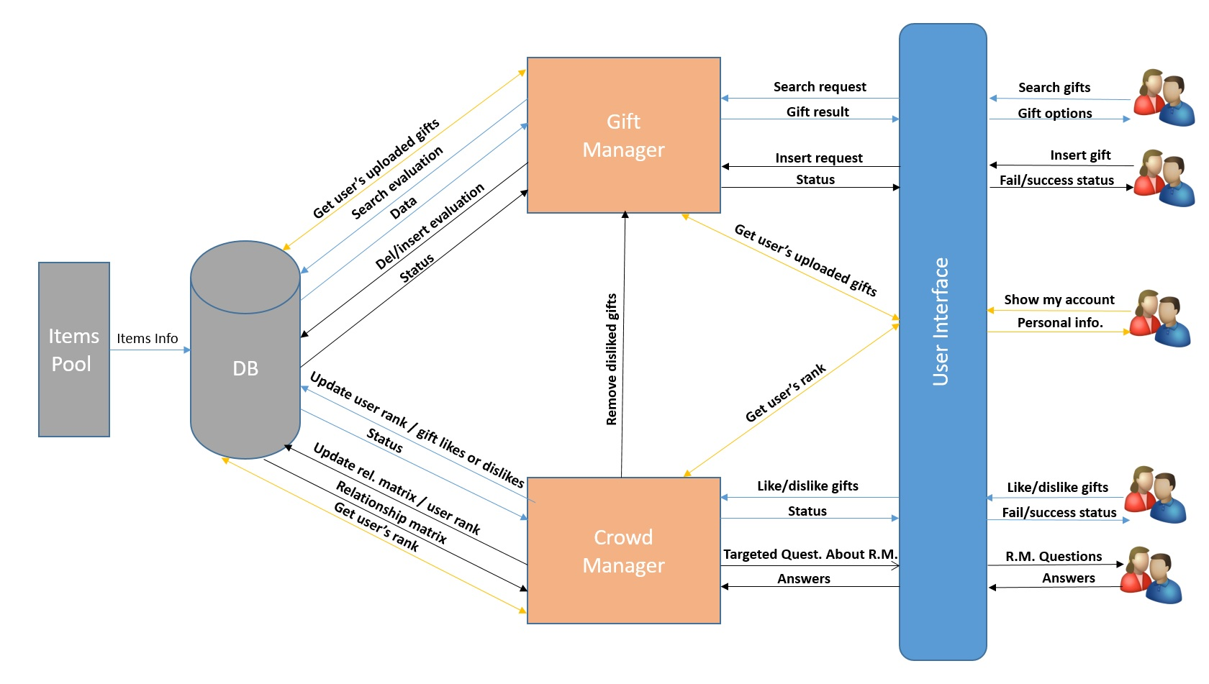
System architecture

Slide 6
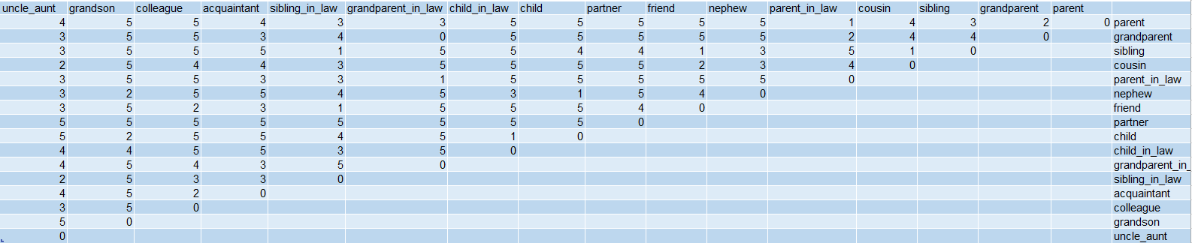
Default Relationship matrix

